Slide 1
Designing interactions between Tangibles
Presented by Faroukh Davouzov

Slide 2
Table of Contents
Introduction
Related Work
Implementation

Slide 3
Introduction

Slide 4


What are tangibles?
In context of Human-Computer Interaction
Physical objects to manipulate digital information
Ex: Physical Globe to manipulate world map information

Slide 5
Why use tangible interfaces?
Enhance learning across disciplines
Provides deeper understanding and memory retention
Promote inclusivity and accessibility in educationqz
Encourage social interaction and collaboration

Slide 6
Embodied Cognition
Embodied cognition emphasizes physical experiences in understanding
Importance of body movement, senses and experiences
David Kirsh key points
Using tools changes how we think
Cognition is not just the brain
Active learning works best
Objects help us think

Slide 7
GOAL
Focus not only the interation with digital information but also collaboration
How can tangibles interact with each other?

Slide 8
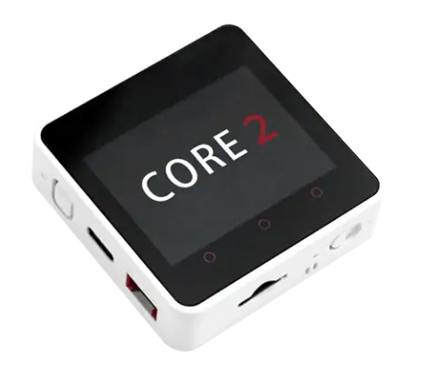
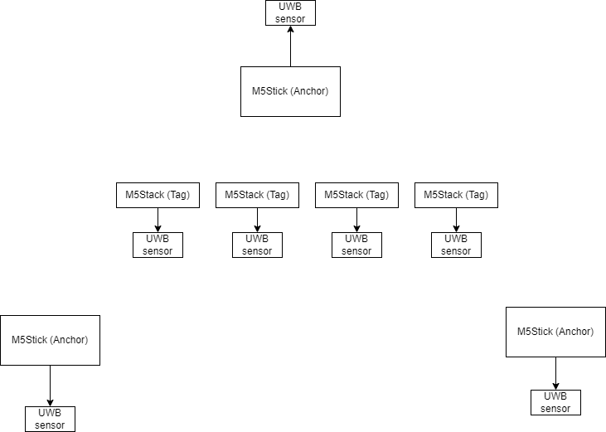
GOAL

Slide 9
Research questions
How can multiple tangible objects synchronize and coordinate their states and actions to provide an effective learning experience?

Slide 10
Research questions
What methods and technologies provide the most accurate and reliable spatial awareness and positioning for tangible objects in an interative learning environment?

Slide 11
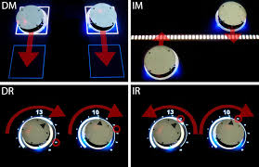
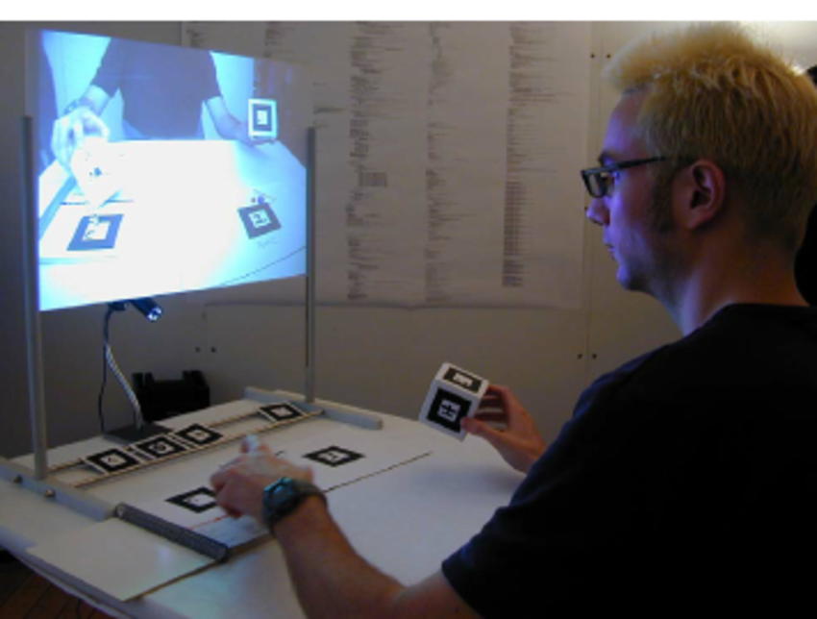
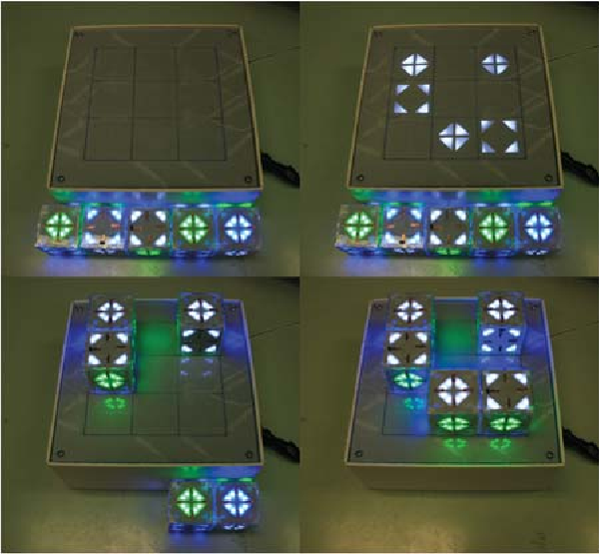
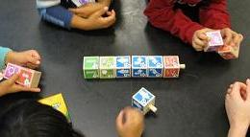
Tangible User Interfaces
Memorix
Recreate pattern
Tern
Plug and play style
Tangible bots
Controlling multiple bots at once
Chemistry education
Combining atoms and molecules
Tangible bots
Chemistry education
Tern programming
Memorix

Slide 12
Tangible User Interfaces
Feedback via large display (tabletop or screen)
Interaction between tangible rather simple
More plug and play style
Limited feedback to the user from the tangibles

Slide 13
Location Tracking in TUIs
Tabletops
Memorix, tangible bots, reacTable
Computer vision
Tern, Microsoft Fusion
Head Mounted Display
CheckMate

Slide 14
Location Tracking in TUIs
Too much hardware needed
Not user friendly
Not convenient to wear an HMD, also expensive
Limited space with computer vision system

Slide 15
Indoor Positioning Technologies
WiFi
Bluetooth
ZigBee
RFID
Ultra-Wideband
Visible Light
Acoustic signals
Ultrasound

Slide 16
Indoor Positioning Technologies
Selection depends on various factors
Accuracy
Price
Scalability
Energy efficiency
Environmental

Slide 17
TangoJudo Interface
Learn the katas from judo via tangibles

Slide 18
TangoJudo Interface: Interactions
Tangibles know each others positions
Triangulation
Can indicate which ones to be switched
E.g. Arrow indicator
Once ordered, video will play kata in order
Tangibles know each others orientation
E.g. Loop arrow

Slide 19
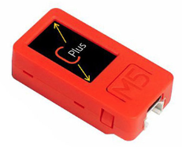

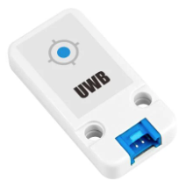
TangoJudo Interface: Implementation
4 pieces - M5Stack Core2
3 pieces – M5StickC
7 pieces – UWB Sensor
Arduino (Software)
Local Server

Slide 20
TangoJudo Interface: Implementation

Slide 21
Challenges
Implementation

Slide 22
Future Plans
Implementation
Local Server
Interactions
Evaluation

